Slide 1

Note: The data and information in this document is reflective of a hypothetical situation and client. This document is to be used for KPMG Virtual Internship purposes only.
Sprocket Central Pty Ltd
Data analytics approach
[Division Name] - [Engagement Manager], [Senior Consultant], [Junior Consultant]

Slide 2
Note: The data and information in this document is reflective of a hypothetical situation and client. This document is to be used for KPMG Virtual Internship purposes only.
Agenda
Introduction
Data Exploration
Model Development
Interpretation

Slide 3
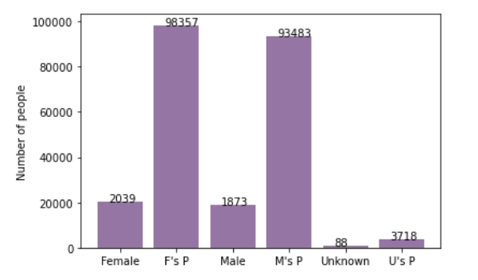
Note: The data and information in this document is reflective of a hypothetical situation and client. This document is to be used for KPMG Virtual Internship purposes only.
Introduction
Place headline insight or information here. This should be the most important point for this slide.
Place any information about this point here.
Place any supporting images, graphs, data or extra text here.

Slide 4
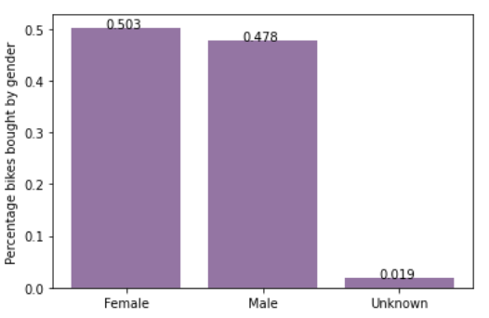
Note: The data and information in this document is reflective of a hypothetical situation and client. This document is to be used for KPMG Virtual Internship purposes only.
Data Exploration
Place headline insight or information here. This should be the most important point for this slide.
Place any information about this point here.
Place any supporting images, graphs, data or extra text here.

Slide 5
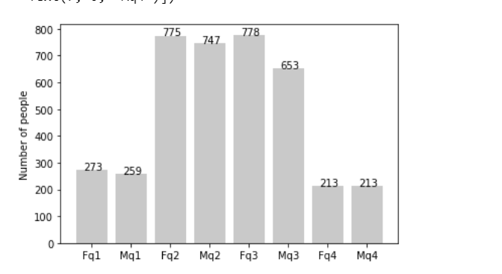
Note: The data and information in this document is reflective of a hypothetical situation and client. This document is to be used for KPMG Virtual Internship purposes only.
Model Development
Place headline insight or information here. This should be the most important point for this slide.
Place any information about this point here.
Place any supporting images, graphs, data or extra text here.

Slide 6
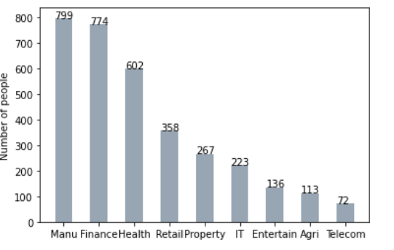
Note: The data and information in this document is reflective of a hypothetical situation and client. This document is to be used for KPMG Virtual Internship purposes only.
Interpretation
Place headline insight or information here. This should be the most important point for this slide.
Place any information about this point here.
Place any supporting images, graphs, data or extra text here.

Slide 7
Note: The data and information in this document is reflective of a hypothetical situation and client. This document is to be used for KPMG Virtual Internship purposes only.
Appendix

Slide 8
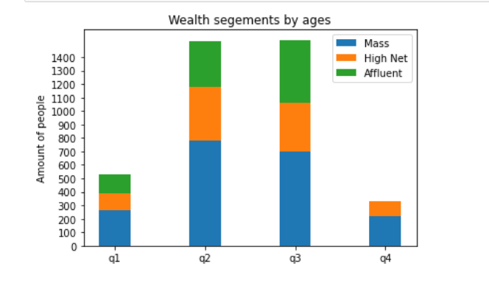
Note: The data and information in this document is reflective of a hypothetical situation and client. This document is to be used for KPMG Virtual Internship purposes only.
Appendix
This is an optional slide where you may place any supporting items.

Slide 9
Possible Student Considerations for Data Analytics Approach
DATA EXPLORATION
Understand the characteristics of given fields in the underlying data such as variable distributions, whether the dataset is skewed towards a certain demographic and the data validity of the fields. For example, a training dataset may be highly skewed towards the younger age bracket. If so, how will this impact your results when using it to predict over the remaining customer base. Identify limitations surrounding the data and gather external data which may be useful for modelling purposes. This may include bringing in ABS data at different geographic levels and creating additional features for the model. For example, the geographic remoteness of different postcodes may be used as an indicator of proximity to consider to whether a customer is in need of a bike to ride to work. Exploration of interactions between different variables through correlation analysis and look out for multicollinearity by creating interaction variables. An example of this correlation may occur between independent variables age and tenure – i.e. people of the older brackets will have a longer tenure. Furthermore, transformation of required data so that it is in an appropriate format for analysis. This may include steps such as ensuring that the data types are appropriate and rolling data up to an aggregated level. Or, joining in already aggregated ABS data at a geographic level to create additional variables. Document assumptions, limitations and exclusions for the data; as well as how you would further improve in the next stage if there was additional time to address assumptions and remove limitations.

Slide 10
MODEL DEVELOPMENT
Determine a hypothesis related to the business question that can be answered with the data. Perform statistical testing to determine if the hypothesis is valid or not. Create calculated fields based on existing data, for example, convert the D.O.B into an age bracket. Other fields that may be engineered include ‘High Margin Product’ which may be an indicator of whether the product purchased by the customer is in a high margin category in the past three months based on the fields ‘list_price’ and ‘standard cost’. Other examples include, calculating the distance from office to home address to as a factor in determining whether customers may purchase a bicycle for transportation purposes. Additionally, this may include thoughts around determining what the predicted variable actually is. For example, are results predicted in ordinal buckets, nominal, binary or continuous. Test the performance of the model using factors relevant for the given model chosen (i.e. residual deviance, AIC, ROC curves, R Squared). Appropriately document model performance, assumptions and limitations.

Slide 11
INTEPRETATION AND REPORTING
Visualisation and presentation of findings. This may involve interpreting the significant variables and co-efficient from a business perspective. These slides should tell a compelling storing around the business issue and support your case with quantitative and qualitative observations. Please refer to module below for further details

